Slide 1
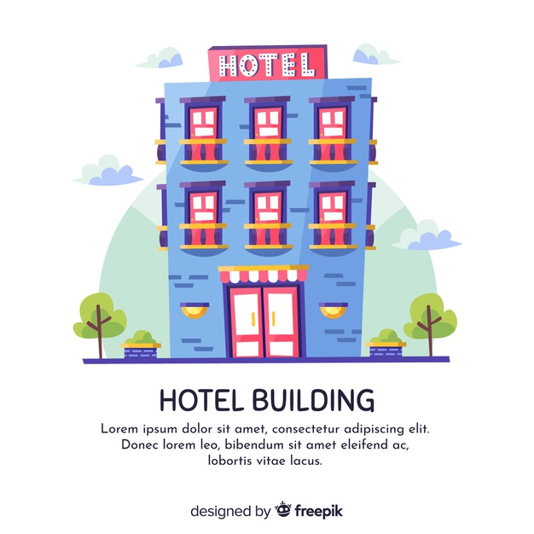
PROJECT
REPORT
Innkeep

Slide 2
TABLE OF CONTENTS
01
ABOUT INNKEEP
04
ANALYSIS AND DESIGN
02
SCOPE AND PURPOSE
05
IMPLEMENTATION
03
USER CHARACTERISTICS
06
FUTURE IMPROVEMENTS
A brief
The hows
The whys
The whats
The whos
The tomorrows

Slide 3

01
ABOUT INNKEEP
A Brief

Slide 4
PRODUCT OVERVIEW
It will allow administrators to monitor and keep track of day-to-day issues raised by inhabitants and address them reliably and efficiently with the comprehensive dashboard with integrated task assigning module. The added features of automating logging in of data for existing manual paper entry.
Purpose of developing this specialised variant of a “Property Management System” is to reduce the workload and simplify day-to-day tasks of the business administrators and improve efficiency and coordination. It also aims to eliminate paperwork completely that has become the primary form of record keeping in many small scale businesses which is not feasible in the long run.

Slide 5
PRODUCT CONTEXT
The concept behind Innkeep is to build an all purpose software that can be used to manage businesses or property alike. Although the initial idea was to build a hostel specific software, we decided to instead make it as general purpose as possible. This software can be adopted to manage any business that lends out a resource as a service, i.e Restaurants, hotels or Car rentals.
The function of Innkeep is to keep a dynamic overview of a business. It allows for constant monitoring of resources and dynamic response to customer to increase customer relations. The swiftness with which issues can be resolved increases customer satisfaction increases future engagements for the business.

Slide 6
02
SCOPE AND PURPOSE
The whats

Slide 7
NEED FOR THIS
With the increase in digitization of society in general from digital marketing to digital payments, the world has moved ahead in terms of technology. Even with such abundance, technology is still seen as a tool of the affluent. The average business still hesitates to invest in technology to increase efficiency of their businesses and do not understand the usefulness of data driven analytics.
We wanted to create a product that can be operated with relative ease and keep track of their businesses. The simple modular nature means it can be adjusted to every need.

Slide 8
03
USER CHARACTERISTICS
The whos

Slide 9
ADMIN
the owner or manager of the business running this product
Is able to see booked resources, can adjust price, modify reservations
Is able to Add/Remove resources or possible users of the system
Is able to observe Statistics - Inventory

Slide 10
GUESTS
Can Make reservation, check rates
While is in its stay can view if the room is ready by the cleaner or not
Can modify their requests and edit their credentials

Slide 11
STAFF
Will receive tasks allotted by the admin
Can update the progress of the task

Slide 12
04
ANALYSIS AND DESIGN
The hows

Slide 13
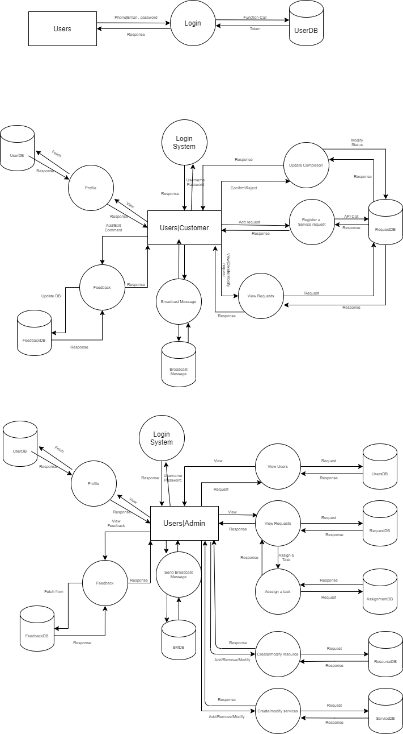
Dataflow Diagram
DFD Level 0
DFD Level 1
DFD Level 2

Slide 14
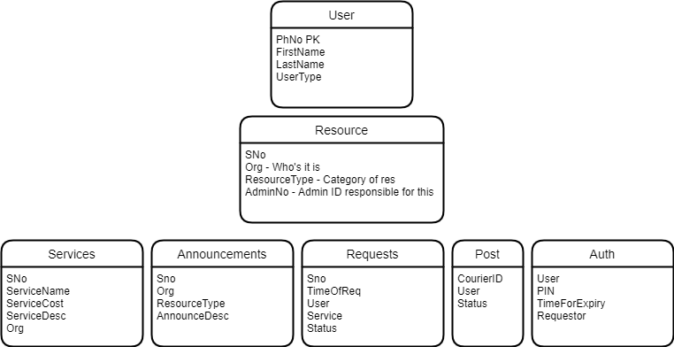
ER Diagram
Simulation of a ERD for the NoSQL DB

Slide 15
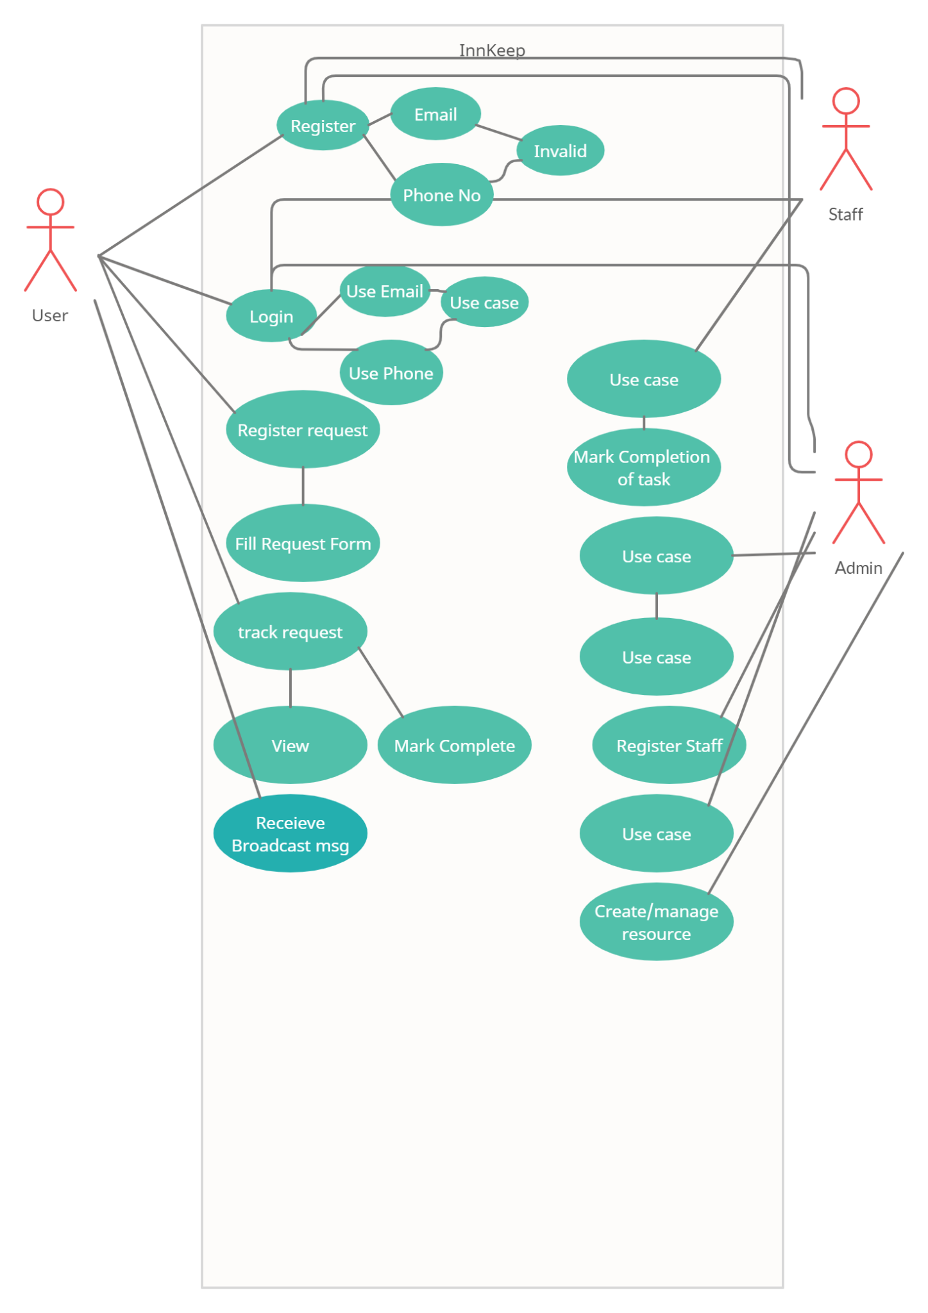
USE CASE DIAGRAM

Slide 16
05
IMPLEMENTATION
The whys

Slide 17
Project Setup
A basic app was set up and pushed into Github to use its version control so both developers can work on the project and collaborate.
After creating a basic app, we hosted it on Heroku.
Integrated ESLint, a linting tool
We used Vue-CLI's development server for development on local, which is fast compared to the node server since we don't need to build every time for production.
Hot module replacement(HMR) was enabled using Vue-CLI which watches the live changes in the files and updates the application automatically.
By using Vuex store(uses FLUX architecture internally) for centralized data management, and Vue-router for managing the dynamic application routes.

Slide 18
First Steps
The first point of contact for the customer would be the authentication page.
We implemented an email-password sign in and sign up page.
The authentication was handled by Fireauth, which encrypted passwords with multiple encryption algorithms ensuring data safety compared to others.

Slide 19
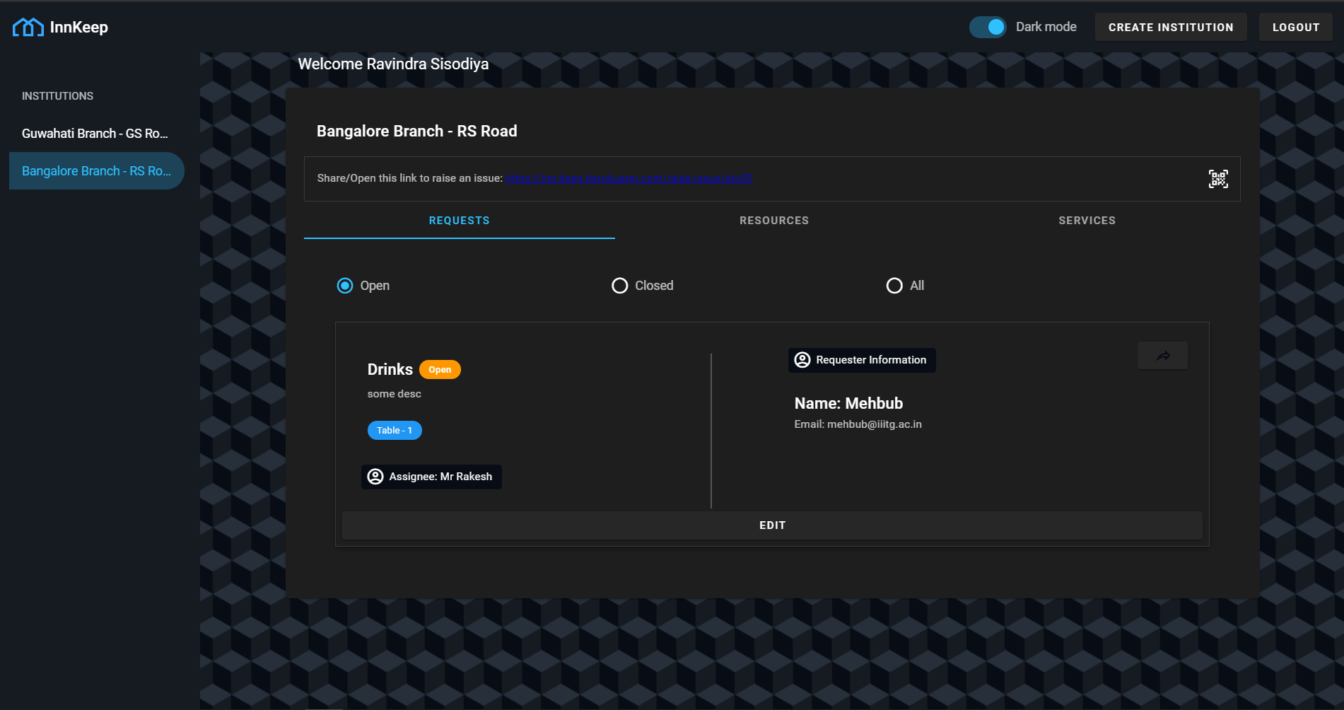
Dashboard
As seen from the screenshot, the admin can navigate through the application from a single screen and access all the details they need. They can add, remove and modify any elements or aspect of their business with a few easy clicks.

Slide 20
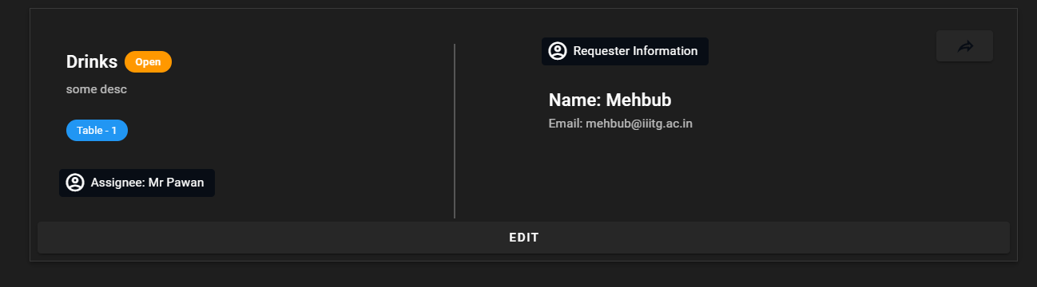
Requests Tab
The requests tab keeps a list of real time generated requests by guests, it allows for the admin to update the request when it's done. They can further assign an employee to address the request. They can also see who has requested it and this data is stored on record indefinitely.

Slide 21
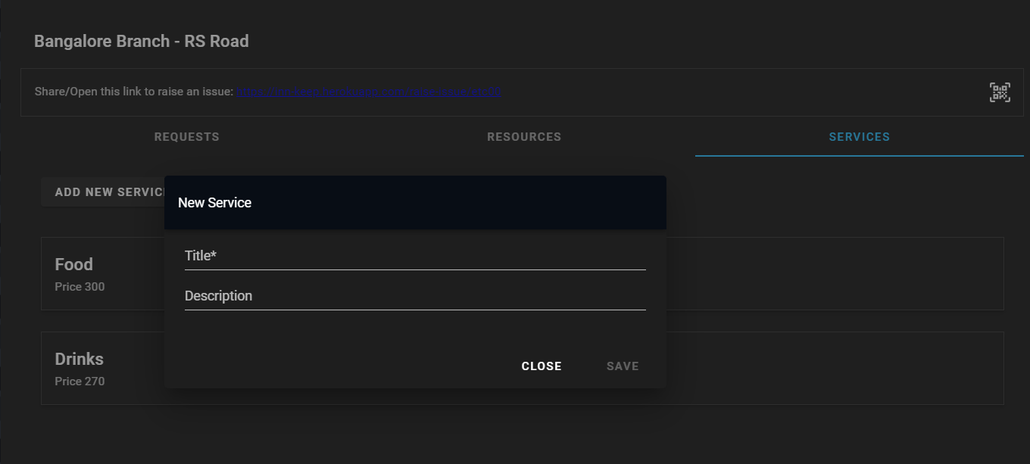
Services Tab
The services tab is used to create new services, in this case a menu. Guests can choose strictly only out of the service listed in this. Adding an element or removing one immediately shows effect and changes teh menu dynamically.

Slide 22
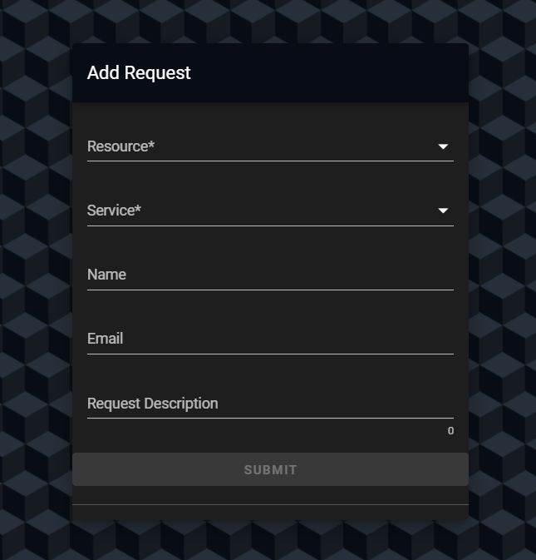
Filing a request
Guests are presented with this form. They can access this through a static QR code that is presented to the Admin when they create a new institution. By filling out this form they will receive a tracking code to the person’s email. Through which they can track the status of their requests. The mailing mechanism will be explained in its own section.

Slide 23
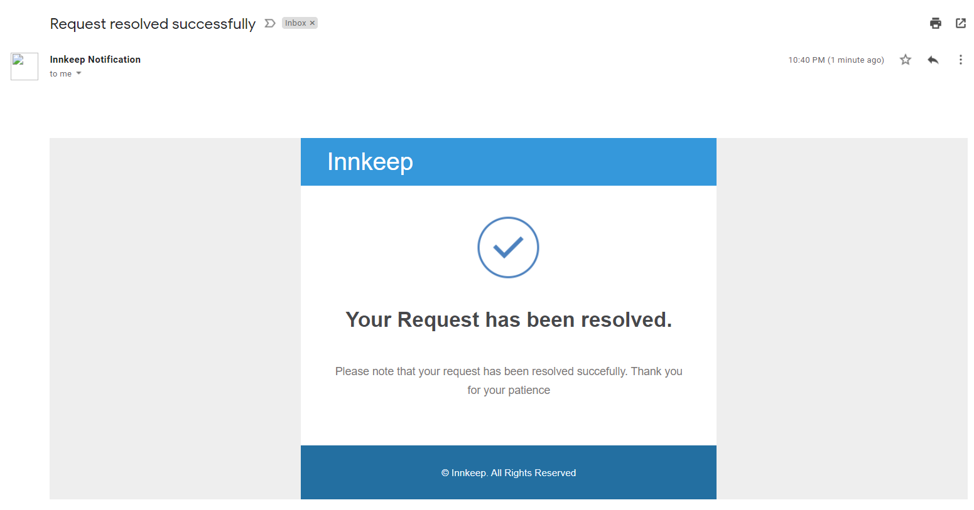
Mailing System
To send email to guests/users, we built our very own mailing framework through which we can send HTML-styled email to users in real time. Taking advantage of gmail’s pre existing mailing infrastructure we can send mails with HTML templates to our users with minimal delay.
The API is used twice, when creating a request and when updating a request. We wrote and styled our very own email template to make our mails look aesthetic. In the case of an undelivered email, the failure is processed safely by rejecting the promise and then retrying after a small delay.

Slide 24
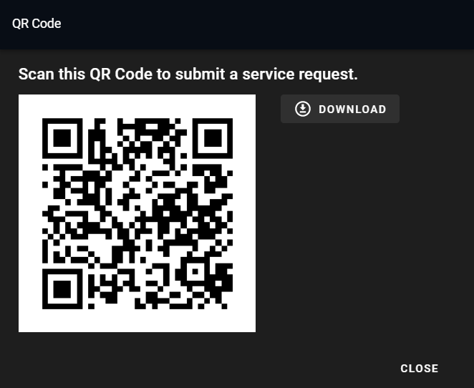
QR Code
The digital QR code is generated out of a unique link for each occurrence of an institution. This was done to greatly increase ease of use for the customer. They can scan this code with their mobile phones and immediately redirect to the Request filing form.

Slide 25
05
FUTURE IMPROVEMENTS
The tomorrows

Slide 26
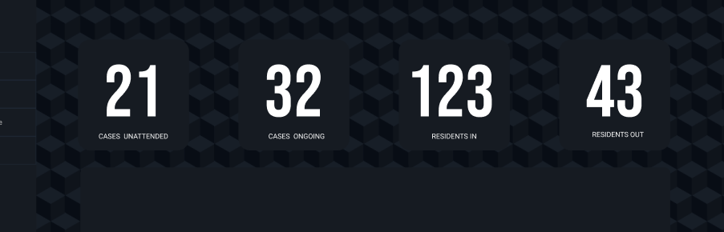
Dashboard Analytics
We aim to include a dashboard analytic deck to the application to display useful information at the top. A primitive version has been implemented for now but needs to be improved.

Slide 27
Secure Take-away system
The app will also need a takeaway system that will monitor and authentic physical transactions so that it can be logged in to the system and archived. It also plays a role in a sort of KYC verification so there aren’t misplaced orders/transactions.

Slide 28
THANK YOU !
Prepared By:
Yashwanth Manivannan
Ravindra Singh Sisodiya

